Slide 1
DPIM Level 2 : Design(System Design)

Slide 2
Overview
System Design I
  0. Overview of System Design
  1. Design Goals
  2. Subsystem Decomposition
    Architectural Styles
System Design II
  3. Concurrency
  4. Hardware/Software Mapping
  5. Persistent Data Management
  6. Global Resource Handling and Access Control
  7. Software Control
  8. Boundary Conditions

Slide 3
System Design
8. Boundary
Conditions
1. Design Goals
Definition
Trade-offs
Initialization
Termination
Failure
2. Subsystem Decomposition
7. Software
Control
Layers vs Partitions
Coherence/Coupling
Monolithic
Event-Driven
Conc. Processes
3. Concurrency
Identification of
Threads
4. Hardware/
Software Mapping
5. Data
Management
6. Global Resource
Handlung
Special Purpose
Buy vs Build
Allocation of Resources
Connectivity
Persistent Objects
File system vs Database
Access Control List
vs Capabilities
Security

Slide 4
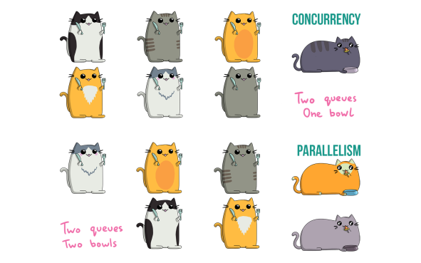
Concurrency
Nonfunctional Requirements to be addressed: Performance, Response time, latency, availability.
Two objects are inherently concurrent if they can receive events at the same time without interacting
  Source for identification: Objects in a sequence diagram that can simultaneously receive events
    Unrelated events, instances of the same event
Inherently concurrent objects can be assigned to different threads of control
Objects with mutual exclusive activity could be folded into a single thread of control
Notes:
Objects with mutual exclusive activity could be folded into a single thread of control (Why?)
Should client and server of a client/server architecture be folded on the same thread?
If there are multiple clients?
If there is only a single client and the server?.

Slide 5
Thread of Control
A thread of control is a path through a set of state diagrams on which a single object is active at a time
  A thread remains within a state diagram until an object sends an event to different object and waits for another event
Concurrent threads can lead to race conditions.
A race condition (also race hazard) is a design flaw where the output of a process is depends on the specific sequence of other events.
  The name originated in digital circuit design: Two signals racing each other to influence the output.
Notes:
Example: An instance of a client/server architectural style consists of at least two threads
A race condition or race hazard is a flaw in a system or process whereby the output and/or result of the process is unexpectedly and critically dependent on the sequence or timing of other events. The term originates with the idea of two signals racing each other to influence the output first.

Slide 6
System Design
8. Boundary
Conditions
1. Design Goals
Definition
Trade-offs
Initialization
Termination
Failure
2. Subsystem Decomposition
7. Software
Control
Layers vs Partitions
Coherence/Coupling
Monolithic
Event-Driven
Conc. Processes
3. Concurrency
Identification of
Threads
4. Hardware/
Software Mapping
5. Data
Management
6. Global Resource
Handlung
Special Purpose
Buy vs Build
Allocation of Resources
Connectivity
Persistent Objects
Filesystem vs Database
Access Control List
vs Capabilities
Security

Slide 7

4. Hardware Software Mapping
This system design activity addresses two questions:
  How shall we realize the subsystems: With hardware or with software?
  How do we map the object model onto the chosen hardware and/or software?
    Mapping the Objects:
      Processor, Memory, Input/Output
    Mapping the Associations:
      Network connections
Notes:
A first heuristic would be Control objects need a processor, Entity objects need memory
Boundary objects should be mapped to input/output devices.
These abstractions are available in hardware as well as in software.

Slide 8
Mapping Objects onto Hardware
Control Objects -> Processor
  Is the computation rate too demanding for a single processor?
  Can we get a speedup by distributing objects across several processors?
  How many processors are required to maintain a steady state load?
Entity Objects -> Memory
  Is there enough memory to buffer bursts of requests?
Boundary Objects -> Input/Output Devices
  Do we need an extra piece of hardware to handle the data generation rates?
  Can the desired response time be realized with the available communication bandwidth between subsystems?
Notes:
Does the response time exceed the available bandwith for a task and a piece of hardware?

Slide 9

Mapping the Associations: Connectivity
Describe the physical connectivity
  (“physical layer in the OSI Reference Model”)
    Describes which associations in the object model are mapped to physical connections.
Describe the logical connectivity (subsystem associations)
  Associations that do not directly map into physical connections.
  In which layer should these associations be implemented?
Informal connectivity drawings often contain both types of connectivity
  Practiced by many developers, sometimes confusing.
Notes:
Describe the physical connectivity of the hardware
This is usually the physical layer in the OSI Reference Model
Which associations in the object model are mapped to physical connections?
Which of the client-supplier relationships in the analysis/design model correspond to physical connections?
Describe the logical connectivity (subsystem associations)
Identify associations that do not directly map into physical connections:
How should these associations be implemented?

Slide 10

Hardware-Software Mapping Difficulties
Much of the difficulty of designing a system comes from addressing externally-imposed hardware and software constraints
  Certain tasks have to be at specific locations
    Example: Withdrawing money from an ATM machine
  Some hardware components have to be used from a specific manufacturer
    Example: To send DVB-T signals, the system has to use components from a company that provides DVB-T transmitters.

Slide 11

Hardware/Software Mappings in UML
A UML component is a building block of the system. It is represented as a rectangle with a tabbed rectangle symbol inside
Components have different lifetimes:
  Some exist only at design time
    Classes, associations
  Others exist until compile time
    Source code, pointers
  Some exist at link or only at runtime
    Linkable libraries, executables, addresses
The Hardware/Software Mapping addresses dependencies and distribution issues of UML components during system design.

Slide 12
Two New UML Diagram Types
Deployment Diagram:
  Illustrates the distribution of components at run-time.
  Deployment diagrams use nodes and connections to depict the physical resources in the system.
Component Diagram:
  Illustrates dependencies between components at design time, compilation time and runtime

Slide 13
Deployment Diagram
Deployment diagrams are useful for showing a system design after these system design decisions have been made:
  Subsystem decomposition
  Concurrency
  Hardware/Software Mapping
A deployment diagram is a graph of nodes and connections (“communication associations”)
  Nodes are shown as 3-D boxes
  Connections between nodes are shown as solid lines
  Nodes may contain components
    Components can be connected by “lollipops” and “grabbers”
    Components may contain objects (indicating that the object is part of the component).
:PC
:Server

Slide 14
UML Component Diagram
Used to model the top-level view of the system design in terms of components and dependencies among the components. Components can be
    source code, linkable libraries, executables
The dependencies (edges in the graph) are shown as dashed lines with arrows from the client component to the supplier component:
  The lines are often also called connectors
  The types of dependencies are implementation language specific
Informally also called “software wiring diagram“ because it show how the software components are wired together in the overall application.

Slide 15
UML Interfaces: Lollipops and Sockets
A UML interface describes a group of operations used or created by UML components.
  There are two types of interfaces: provided and required interfaces.
    A provided interface is modeled using the lollipop notation
    A required interface is modeled using the socket notation.
A port specifies a distinct interaction point between the component and its environment.
  Ports are depicted as small squares on the sides of classifiers.

Slide 16
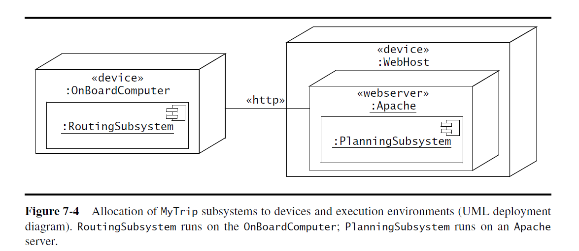
Deployment Diagram Example

Slide 17
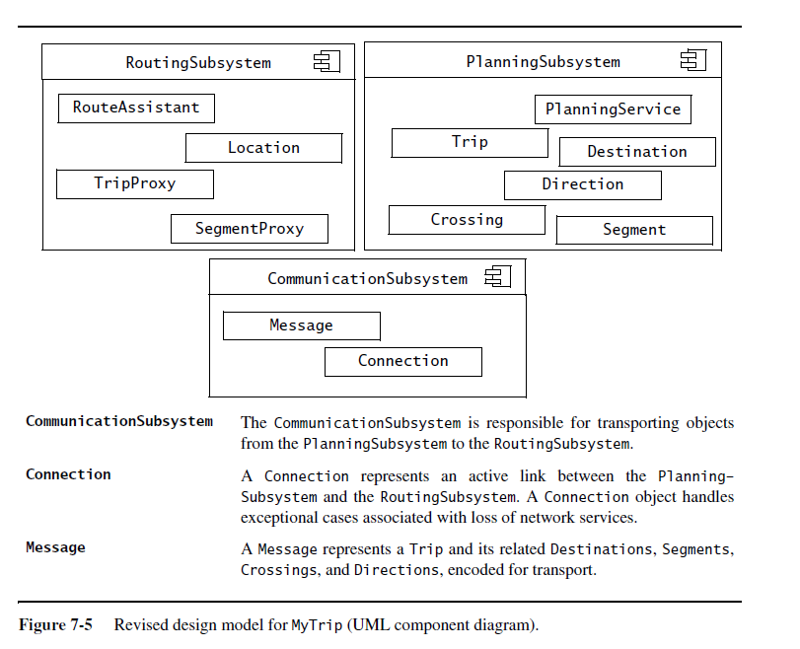
Component Diagram Example

Slide 18

5. Data Management
Some objects in the system model need to be persistent:
  Values for their attributes have a lifetime longer than a single execution
A persistent object can be realized with one of the following mechanisms:
  Filesystem:
    If the data are used by multiple readers but a single writer
  Database:
    If the data are used by concurrent writers and readers.
Notes:
Some objects in the system model need to be persistent
Provide clean separation points between subsystems with well-defined interfaces.
Data structure
If the data can be volatile
Files
If the data has a lifetime longer than a single execution
Cheap, simple, permanent storage
Low level (Read, Write)
Applications must add code to provide suitable level of abstraction
Database
Powerful, easy to port
Supports multiple writers and readers

Slide 19

Data Management Questions
How often is the database accessed?
  What is the expected request (query) rate? The worst case?
  What is the size of typical and worst case requests?
Do the data need to be archived?
Should the data be distributed?
  Does the system design try to hide the location of the databases (location transparency)?
Is there a need for a single interface to access the data?
  What is the query format?
Should the data format be extensible?
Notes:
Should the database be relational or object-oriented?

Slide 20
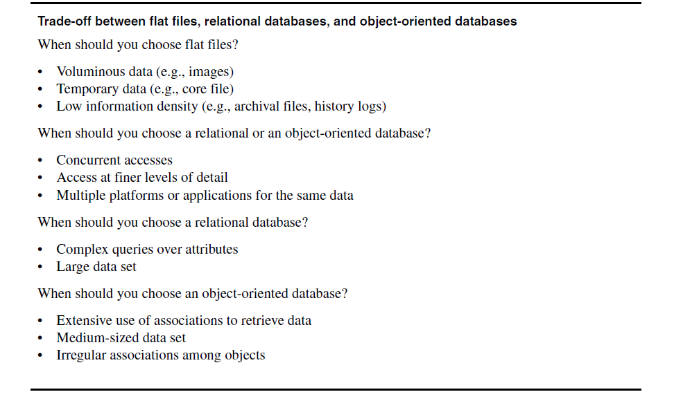

Slide 21
Mapping Object Models
UML object models can be mapped to relational databases
The mapping:
  Each class is mapped to its own table
  Each class attribute is mapped to a column in the table
  An instance of a class represents a row in the table
  One-to-many associations are implemented with a buried foreign key
  Many-to-many associations are mapped to their own tables
Methods are not mapped
Notes:
UML object models can be mapped to relational databases
Some degradation occurs because all UML constructs must be mapped to a single relational database construct - the table
UML mappings (Chapter 10, p 414ff)

Slide 22

6. Global Resource Handling
Discusses access control
Describes access rights for different classes of actors
Describes how object guard against unauthorized access.

Slide 23

Defining Access Control
In multi-user systems different actors usually have different access rights to different functionality and data
How do we model these accesses?
  During analysis we model them by associating different use cases with different actors
  During system design we model them determining which objects are shared among actors.
Notes:
During system design we model them by examining the object model by determining which objects are shared among actors.
Depending on the security requirements of the system, we also define how actors are authenticated
to the system and how selected data in the system should be encrypted.

Slide 24
Access Matrix
We model access on classes with an access matrix:
  The rows of the matrix represents the actors of the system
  The column represent classes whose access we want to control
Access Right: An entry in the access matrix. It lists the operations that can be executed on instances of the class by the actor.

Slide 25
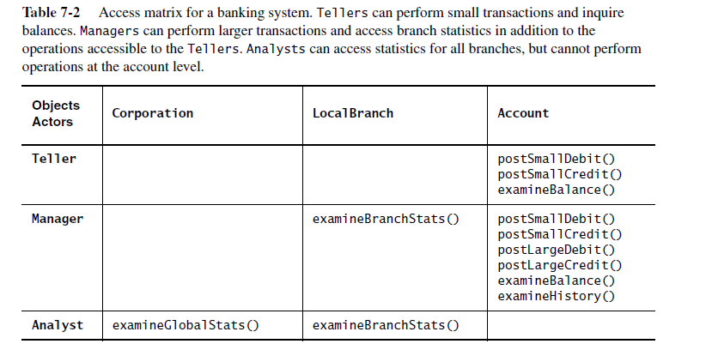

Slide 26
Better Access Matrix Implementations
Access control list
  Associates a list of (actor,operation) pairs with each class to be accessed.
  Every time an instance of this class is accessed, the access list is checked for the corresponding actor and operation.
Capability
  Associates a (class,operation) pair with an actor.
  A capability provides an actor to gain control access to an object of the class described in the capability.
Notes:
Access control list associates a list of (actor,operation) pairs with each class to be accessed.
Every time an object is accessed, its access list is checked for the corresponding actor and operation.
Example: guest list for a party.
A capability associates a (class,operation) pair with an actor.
A capability provides an actor to gain control access to an object of the class described in the capability.
Example: An invitation card for a party.
Which is the right implementation?

Slide 27
Match
Player
play()
forfeit()

Slide 28
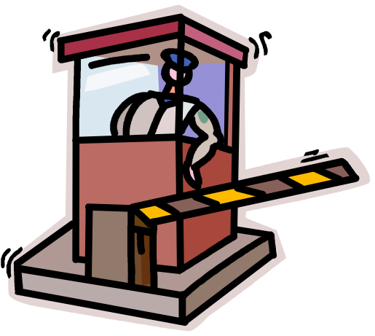
Access Control List Realization
Access Control List for m1
I am joe,
I want to play in match m1
m1:Match
joe may play
alice may play
joe:Player
Gatekeeper checks identification against list and allows access.

Slide 29

Capability Realization
Here’s my ticket, I’d like to play in match m1
m1:Match
joe:Player
Gatekeeper checks if ticket is valid and allows access.
Ticket for
match “m1”
Capability

Slide 30
Global Resource Questions
Does the system need authentication?
If yes, what is the authentication scheme?
  User name and password? Access control list
  Tickets? Capability-based
What is the user interface for authentication?
Does the system need a network-wide name server?
How is a service known to the rest of the system?
  At runtime? At compile time?
  By Port?
  By Name?

Slide 31
7. Decide on Software Control
Two major design choices:
1. Choose implicit control
2. Choose explicit control
  Centralized or decentralized
Centralized control:
  Procedure-driven: Control resides within program code.
  Event-driven: Control resides within a dispatcher calling functions via callbacks.
Decentralized control
  Control resides in several independent objects.
    Examples: Message based system, RMI
  Possible speedup by mapping the objects on different processors, increased communication overhead.
Notes:
Two major design choices:
1. Choose implicit control (non-procedural, declarative languages)
Rule-based systems
Logic programming
2. Choose explicit control (procedural languages): Centralized or decentralized
In the case of centralized control we have another choice: Procedure-driven or event-driven?
Procedure-driven control
Control resides within program code. Example: Main program calling procedures of subsystems.
Simple, easy to build, hard to maintain (high recompilation costs)
Event-driven control
Control resides within a dispatcher calling functions via callbacks.
Very flexible, good for the design of graphical user interfaces, easy to extend

Slide 32
Software Control
Explicit Control
Implicit Control
Rule-based
Control
Logic Programming
Decentralized
Control
Centralized
Control
Event-based
Control
Procedural
Control.

Slide 33
Centralized vs. Decentralized Designs
Centralized Design
  One control object or subsystem ("spider") controls everything
    Pro: Change in the control structure is very easy
    Con: The single control object is a possible performance bottleneck
Decentralized Design
  Not a single object is in control, control is distributed; That means, there is more than one control object
    Con: The responsibility is spread out
    Pro: Fits nicely into object-oriented development

Slide 34
Centralized vs. Decentralized Designs (2)
Should you use a centralized or decentralized design?
Take the sequence diagrams and control objects from the analysis model
Check the participation of the control objects in the sequence diagrams
  If the sequence diagram looks like a fork => Centralized design
  If the sequence diagram looks like a stair => Decentralized design.

Slide 35

8. Boundary Conditions
Initialization
  The system is brought from a non-initialized state to steady-state
Termination
  Resources are cleaned up and other systems are notified upon termination
Failure
  Possible failures: Bugs, errors, external problems
Good system design foresees fatal failures and provides mechanisms to deal with them.
Notes:
Most of the system design effort is concerned with the steady-state behavior described
in the analysis phase.
However, the system design phase must also address
the initiation and finalization of the system.
This is done with a set of new uses cases called administration use cases
Initialization
Describes how the system is brought from an non initialized state to steady-state ("startup use cases”)
Termination
Describes what resources are cleaned up and which systems are notified upon termination ("termination use cases")
Failure
Describes possible failures: Bugs, errors, external problems (power supply).
Good system design foresees fatal failures (“failure use cases”)

Slide 36
Boundary Condition Questions
Initialization
  What data need to be accessed at startup time?
  What services have to registered?
  What does the user interface do at start up time?
Termination
  Are single subsystems allowed to terminate?
  Are subsystems notified if a single subsystem terminates?
  How are updates communicated to the database?
Failure
  How does the system behave when a node or communication link fails?
  How does the system recover from failure?.
Notes:
8.1 Initialization
How does the system start up?
What data need to be accessed at startup time?
What services have to registered?
What does the user interface do at start up time?
How does it present itself to the user?
8.2 Termination
Are single subsystems allowed to terminate?
Are other subsystems notified if a single subsystem terminates?
How are local updates communicated to the database?
8.3 Failure
How does the system behave when a node or communication link fails? Are there backup communication links?
How does the system recover from failure? Is this different from initialization?

Slide 37
Modeling Boundary Conditions
Boundary conditions are best modeled as use cases with actors and objects
We call them boundary use cases or administrative use cases
Actor: often the system administrator
Interesting use cases:
  Start up of a subsystem
  Start up of the full system
  Termination of a subsystem
  Error in a subsystem or component, failure of a subsystem or component.

Slide 38
ManageServer Boundary Use Case
<<include>>
StartServer
Server
Administrator
<<include>>
ManageServer
ShutdownServer
<<include>>
ConfigureServer

Slide 39
Summary
System design activities:
  Concurrency identification
  Hardware/Software mapping
  Persistent data management
  Global resource handling
  Software control selection
  Boundary conditions
Each of these activities may affect the subsystem decomposition
Two new UML Notations
  UML Component Diagram: Showing compile time and runtime dependencies between subsystems
  UML Deployment Diagram: Drawing the runtime configuration of the system.
Notes:
In this lecture, we reviewed the activities of system design:
….
Each of these activities may affects the subsystem decomposition to address a specific issue
Once these activities are completed, the interface of the subsystems can be defined.
This leads us to Object Design

